Slide 1
Do what's right, rather than what's Easy
Imagine learning Value #4

Slide 2
What makes it Hard to do something Right?
takes a long time
have to collaborate with people
"If you want something done right, do it yourself."

Slide 3
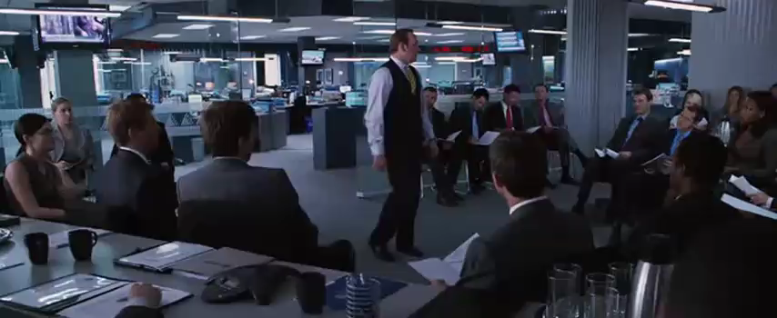

Slide 4
What makes it Hard to do something Right?
takes a long time
have to collaborate with people
"If you want something done right, do it yourself."
have to tell the truth
Integrity

Slide 5
It should be Easy for us to do what’s Right
Simplify

Slide 6
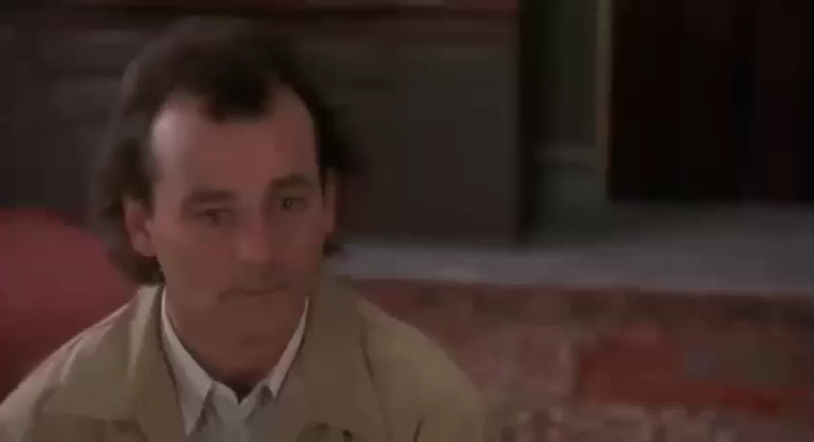

Slide 7
It should be Easy to do what’s Right
Simplify
Be humble and seek feedback
Be honest and speak what’s on your mind

Slide 8
